Slide 1
The Attack and Defense of Computers
Dr. 許 富 皓

Slide 2
HTML Document _{[Mozilla - SphinxKnight]}
An HTML document is a plaintext document structured with elements.
Elements are surrounded by matching opening and closing tags. Each tag begins and ends with angle brackets (<>).

Slide 3
End Tags on void Elements _{[Roger Johansson]}
Most HTML elements have a start tag and an end tag that indicate where the element begins and where it ends.
There is a group of elements that are exceptions to this rule.
These elements are called empty or void and only have a start tag since they can't have any content.
They must not have an end tag in HTML.

Slide 4
Void Elements
The void elements in HTML 4.01/XHTML 1.0 Strict are area, base, br, col, hr, img, input, link, meta, and param.
HTML5 currently adds command, keygen, and source to that list.

Slide 5
Example
To create a button with the input element, do this if you use an HTML
<input type="submit" value="Ok">
Do not do this:
<input type="submit" value="Ok">
</input> <!-- Bad! -->

Slide 6
Attributes of HTML Tags _{[Mozilla - SphinxKnight]}
You can extend HTML tags with attributes, which provide additional information affecting how the browser interprets the element.

Slide 7
HTML Element _{[mozilla - mdnwebdocs-bot]}
An element is a part of a webpage.
In XML and HTML, an element may contain
  a data item or
  a chunk of text or
  an image, or
  perhaps nothing.
A typical element includes an opening tag with some attributes, enclosed text content, and a closing tag.

Slide 8
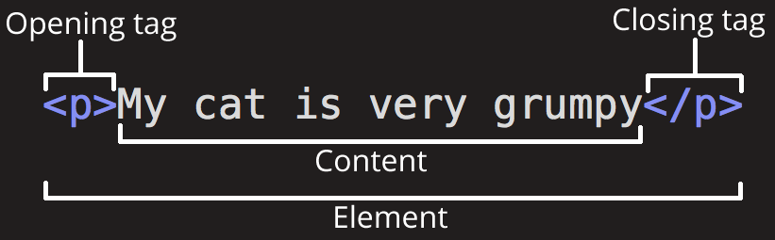
Anatomy of an HTML element _{[mozilla - SphinxKnight]}

Slide 9
The main parts of an element - the opening tag _{[mozilla - SphinxKnight]}
This consists of the name of the element (in this case, p), wrapped in opening and closing angle brackets.
This states where the element begins or starts to take effect — in this case where the start of the paragraph is.

Slide 10
The main parts of an element - the closing tag _{[mozilla - SphinxKnight]}
This is the same as the opening tag, except that it includes a forward slash before the element name.
This states where the element ends — in this case where the end of the paragraph is.
  Failing to include a closing tag is a common beginner error and can lead to strange results.

Slide 11
The main parts of an element - the content _{[mozilla - SphinxKnight]}
This is the content of the element, which in this case is just text.

Slide 12
The main parts of an element _{[mozilla - SphinxKnight]}
The opening tag plus the closing tag plus the content equals the element.

Slide 13
Elements and Tags _{[mozilla - mdnwebdocs-bot]}
Elements and tags are not the same things.
Tags begin or end an element in source code, whereas elements are part of the DOM, the document model for displaying the page in the browser.

Slide 14
DOM _{[mozilla]}

Slide 15
Document
A Web page is a document.
This document can be either displayed in the browser window or as the HTML source. But it is the same document in both cases.
The Document Object Model (DOM) represents that same document so it can be manipulated.

Slide 16
DOM (Document Object Model)
The Document Object Model (DOM) is a programming interface for HTML and XML documents.
It represents the page so that programs can change the document structure, style, and content.
The DOM represents the document as nodes and objects. That way, programming languages can connect to the page.

Slide 17
DOM Standards
The W3C DOM and WHATWG DOM standards are implemented in most modern browsers.
Many browsers extend the standard, so care must be exercised when using them on the web where documents may be accessed by various browsers with different DOMs.

Slide 18
DOM vs. Web Page
The DOM is an object-oriented representation of the web page, which can be modified with a scripting language such as JavaScript.
All of the properties, methods, and events available for manipulating and creating web pages are organized into objects.
This documentation provides an object-by-object reference to the DOM.

Slide 19
Example
The document object that represents the document itself.
The table object that implements the special HTMLTableElement DOM interface for accessing HTML tables, and so forth.

Slide 20
JavaScript and DOM
JavaScript code uses the DOM to access the document and its elements.
The DOM is not a programming language, but without it, the JavaScript language wouldn't have any model or notion of web pages, HTML documents, XML documents, and their component parts (e.g. elements).

Slide 21
Elements in a Document
Every element in a document—the document as a whole, the head, tables within the document, table headers, text within the table cells—is part of the document object model for that document, so they can all be accessed and manipulated using the DOM and a scripting language like JavaScript.

Slide 22
Programming Languages and DOM
In the beginning, JavaScript and the DOM were tightly intertwined, but eventually, they evolved into separate entities.
The page content is stored in the DOM and may be accessed and manipulated via JavaScript.
Nowadays, the DOM was designed to be independent of any particular programming language, making the structural representation of the document available from a single, consistent API.

Slide 23
DOMs of Browsers
You don't have to do anything special to begin using the DOM.
Different browsers have different implementations of the DOM, and these implementations exhibit varying degrees of conformance to the actual DOM standard, but every web browser uses some DOM to make web pages accessible via JavaScript.

Slide 24
JavaScript _{[W3Schools]}

Slide 25
JavaScript Properties
Properties are the values associated with a JavaScript object.
A JavaScript object is a collection of unordered properties.
Properties can usually be changed, added, and deleted, but some are read only.

Slide 26
Accessing JavaScript Properties
The syntax for accessing the property of an object is:
objectName.property // person.age
or
objectName["property"] // person["age"]
or
objectName[expression] // x = "age"; person[x]
The expression must evaluate to a property name.

Slide 27
DOM _{[Mozilla} ₋ _{Sheppy]}

Slide 28
DOM (Document Object Model)
The DOM (Document Object Model) is an API that represents and interacts with any HTML or XML document.
The DOM is a document model loaded in the browser and representing the document as a node tree, where each node represents part of the document (e.g. an element, text string, or comment).

Slide 29
DOM (Document Object Model)
The DOM is one of the most-used APIs on the Web because it allows code running in a browser to access and interact with every node in the document.
Nodes can be created, moved and changed.
Event listeners can be added to nodes and triggered on occurrence of a given event.

Slide 30
DOM (Document Object Model)
DOM was not originally specified—it came about when browsers began implementing JavaScript.
This legacy DOM is sometimes called DOM 0.
Today, the WHATWG maintains the DOM Living Standard.

Slide 31
DOM Types

Slide 32
DOM Types _{[tutorialspoint]}
There are several DOMs in existence.

Slide 33
The Legacy DOM _{[tutorialspoint]}
This is the model which was introduced in early versions of JavaScript language.
It is well supported by all browsers, but allows access only to certain key portions of documents, such as forms, form elements, and images.

Slide 34
The W3C DOM _{[tutorialspoint]}
This document object model allows access and modification of all document content and is standardized by the World Wide Web Consortium (W3C).
This model is supported by almost all the modern browsers.

Slide 35
The IE4 DOM _{[tutorialspoint]}
This document object model was introduced in Version 4 of Microsoft's Internet Explorer browser.
IE 5 and later versions include support for most basic W3C DOM features.

Slide 36
Node Tree _{[w3schools][AndyChen]}

Slide 37
HTML DOM Node Tree _{[w3schools]}
The HTML DOM views an HTML document as a node-tree.
All the nodes in a node tree have relationships to each other.

Slide 38
HTML Document and Node Tree _{[w3schools]}
The HTML DOM views a HTML document as a tree-structure.
The tree structure is called a node-tree.
All nodes can be accessed through the tree.
  Their contents can be modified or deleted, and new elements can be created.

Slide 39
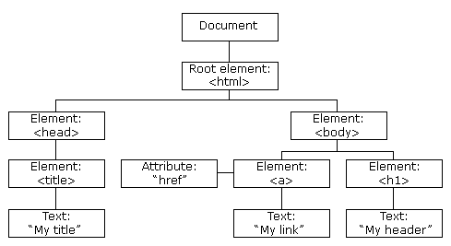
Example _{[w3schools]}
The node tree below shows the set of nodes, and the connections between them. The tree starts at the root node and branches out to the text nodes at the lowest level of the tree:

Slide 40
Node Parents, Children, and Siblings _{[w3schools]}
The nodes in the node tree have a hierarchical relationship to each other.
The terms parent, child, and sibling are used to describe the relationships.
  Parent nodes have children.
  Children on the same level are called siblings (brothers or sisters).
  Siblings are nodes with the same parent.

Slide 41
Terminologies of a Node Tree _{[w3schools]}
In a node tree, the top node is called the root.
Every node, except the root, has exactly one parent node.
A node can have any number of children.
A leaf is a node with no children.

Slide 42
An HTML Document _{[w3schools]}
<html>
<head>
<title>DOM Tutorial</title>
</head>
<body>
<h1>DOM Lesson one</h1>
<p>Hello world!</p>
</body>
</html>

Slide 43
Nodes of the Related Node Tree _{[w3schools]}
In the HTML above, every node except for the document node has a parent node:
  The <html> node has no parent node; the root node
  The parent node of the <head> and <body> nodes is the <html> node
  The parent node of the "Hello world!" text node is the <p> node

Slide 44
Parentship _{[w3schools]}
Most element nodes have child nodes:
  The <html> node has two child nodes; <head> and <body>
  The <head> node has one child node; the <title> node
  The <title> node also has one child node; the text node "DOM Tutorial"
  The <h1> and <p> nodes are siblings, and both child nodes of <body>

Slide 45
DOM Nodes _{[w3schools]}
According to the W3C HTML DOM standard, everything in an HTML document is a node:
  The entire document is a document node
  Every HTML element is an element node
  The text inside HTML elements are text nodes
  Every HTML attribute is an attribute node (deprecated)
  All comments are comment nodes

Slide 46
Example
<p id=“greeting">Hello World</p>
  p is an element node,
  Hello World is a text node,
  id=“greeting“ is an attribute node.

Slide 47
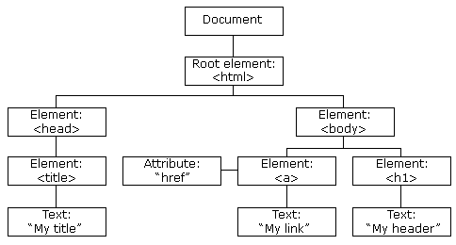
Nodes and JavaScript _{[w3schools]}
With the HTML DOM, all nodes in the node tree can be accessed by JavaScript.
New nodes can be created, and all nodes can be modified or deleted.

Slide 48
DOM Objects

Slide 49
Objects in DOM _{[tutorialspoint]}
Every web page resides inside a browser window which can be considered as an object.
A Document object represents the HTML document that is displayed in that window.
The Document object has various properties that refer to other objects which allow access to and modification of document content.

Slide 50
Object Hierarchy _{[tutorialspoint]}
The objects are organized in a hierarchy.
This hierarchical structure applies to the organization of objects in a Web document.

Slide 51
Window Object _{[tutorialspoint]}
Top of the hierarchy.
It is the outmost element of the object hierarchy.

Slide 52
Document Object _{[tutorialspoint]}
Each HTML document that gets loaded into a window becomes a document object.
The document contains the contents of the page.

Slide 53
Form Object _{[tutorialspoint]}
Everything enclosed in the <form>...</form> tags sets the form object.
  Form control elements − The form object contains all the elements defined for that object such as text fields, buttons, radio buttons, and checkboxes.

Slide 54
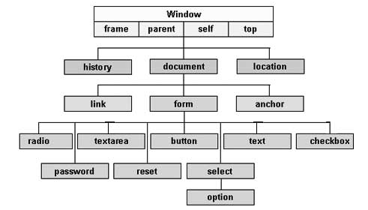
A Simple Hierarchy of a Few Important Objects _{[tutorialspoint]}

Slide 55
The HTML DOM Document Object _{[w3schools]}
The document object represents your web page.
If you want to access any element in an HTML page, you always start with accessing the document object.

Slide 56
Finding HTML Elements _{[w3schools]}
Method | Description
document.getElementById(id) | Find an element by element id
document.getElementsByTagName(name) | Find elements by tag name
document.getElementsByClassName(name) | Find elements by class name

Slide 57
JavaScript and DOM _{[Mozilla} ₋ _{mdnwebdocs-bot]}
The easiest way for web page authors to change the DOM dynamically is using JavaScript.
In JavaScript, the document is accessible the same way it has been in older browsers: from the document property of the global object.
This document object implements the Document interface from the W3C's DOM Level 1 spec.

Slide 58


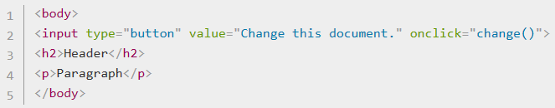
A Simple Example – HTML Content _{[Mozilla} ₋ _{mdnwebdocs-bot]}
Suppose the author wants to take the above document and change the contents of the header, and write two paragraphs instead of one. The following script would do the job:

Slide 59
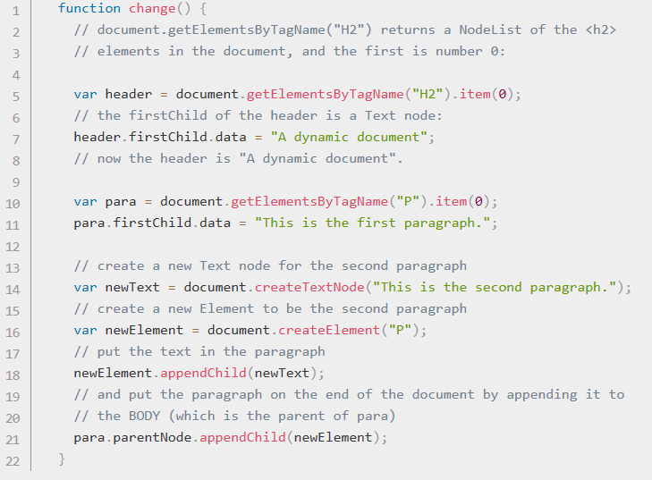
A Simple Example – JavaScript Content _{[Mozilla} ₋ _{mdnwebdocs-bot]}

Slide 60
<html>
<head>
<title>My Document</title>
</head>
<body>
<script>
function change() {
// document.getElementsByTagName("H2") returns a NodeList of the <h2>
// elements in the document, and the first is number 0:
var header = document.getElementsByTagName("H2").item(0);
// the firstChild of the header is a Text node:
header.firstChild.data = "A dynamic document";
// now the header is "A dynamic document".
var para = document.getElementsByTagName("P").item(0);
para.firstChild.data = "This is the first paragraph.";
// create a new Text node for the second paragraph
var newText = document.createTextNode("This is the second paragraph.");
// create a new Element to be the second paragraph
var newElement = document.createElement("P");
// put the text in the paragraph
newElement.appendChild(newText);
// and put the paragraph on the end of the document by appending it to
// the BODY (which is the parent of para)
para.parentNode.appendChild(newElement);
}
</script>
<input type="button" value="Change this document." onclick="change()">
<h2>Header</h2>
<p>Paragraph</p>
</body>
</html>

Slide 61
Element and Node

Slide 62
Element and Node _{[mozilla - itainoam]}
Because the vast majority of code that uses the DOM revolves around manipulating HTML documents, it's common to always refer to the nodes in the DOM as elements, since in an HTML document, each node is an element.
Despite not being strictly accurate, the documentation you'll find on MDN will frequently do the same thing, because of how common this assumption is.

Slide 63
Document and Node Interface _{[mozilla - itainoam]}
Data type (Interface) | Description
Document | When a member returns an object of type document (e.g., the ownerDocument property of an element returns the document to which it belongs), this object is the root document object itself. The DOM document Reference chapter describes the document object.
Node | Every object located within a document is a node of some kind. In an HTML document, an object can be an element node but also a text node or attribute node.

Slide 64
Document interface _{[mozilla - ExE-Boss]}
The Document interface represents any web page loaded in the browser and serves as an entry point into the web page's content, which is the DOM tree.

Slide 65

Document interface _{[mozilla - ExE-Boss]}
The DOM tree includes elements such as <body> and <table> , among many others.
It provides functionality globally to the document, like how to obtain the page's URL and create new elements in the document.
This interface also inherits from the Node and EventTarget interfaces.

Slide 66
Document interface _{[mozilla - ExE-Boss]}
The Document interface describes the common properties and methods for any kind of document.
Depending on the document's type (e.g. HTML, XML, SVG, …), a larger API is available:
  HTML documents, served with the "text/html" content type, also implement the HTMLDocument interface,
  whereas XML and SVG documents implement the XMLDocument interface.

Slide 67
DOM node Class _{[JavaScript.info]}

Slide 68
DOM nodes _{[JavaScript.info]}
Different DOM nodes may have different properties.
  For instance,
    an element node corresponding to tag <a> has link-related properties.
    the one corresponding to <input> has input-related properties and so on.
    Text nodes are not the same as element nodes.

Slide 69
Common Properties and Methods between Different DOM Nodes
    But there are also common properties and methods between all of them, because all classes of DOM nodes form a single hierarchy.

Slide 70
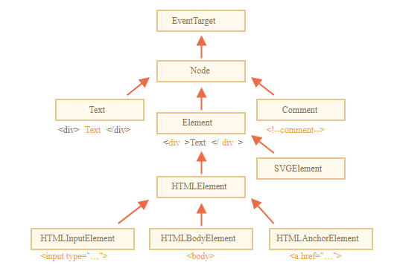
Built-in Classes for DOM Nodes
Each DOM node belongs to the corresponding built-in class.
The root of the hierarchy is EventTarget, that is inherited by Node, and other DOM nodes inherit from it.

Slide 71
Element Interface _{[mozilla - itainoam]}
Data type (Interface) | Description
Element | The element type is based on node. It refers to an element or a node of type element returned by a member of the DOM API. Rather than saying, for example, that the document.createElement() method returns an object reference to a node, we just say that this method returns the element that has just been created in the DOM. element objects implement the DOM Element interface and also the more basic Node interface, both of which are included together in this reference. In an HTML document, elements are further enhanced by the HTML DOM API's HTMLElement interface as well as other interfaces describing capabilities of specific kinds of elements (for instance, HTMLTableElement for <table> elements).

Slide 72
DOM _{[Mozilla} ₋ _{itainoam]}

Slide 73
Document Object Model (DOM)
The Document Object Model (DOM) is a programming interface for HTML and XML documents.
It represents the page so that programs can change the document structure, style, and content.
The DOM represents the document as nodes and objects.
That way, programming languages can connect to the page.

Slide 74
Web Page and Document
A Web page is a document.
  This document can be either
    displayed in the browser window
    or
    as the HTML source.
But it is the same document in both cases.
The Document Object Model (DOM) represents that same document so it can be manipulated.

Slide 75
DOM and Web Page
The DOM is an object-oriented representation of a web page, which can be modified with a scripting language such as JavaScript.

Slide 76
HTML DOM Concepts and Usage
_{[Mozilla} ₋ _{ihargit]}

Slide 77
HTML DOM API
The HTML DOM API is made up of the interfaces that define the functionality of each of the elements in HTML.

Slide 78
Document Object Model (DOM)
The Document Object Model (DOM) is an architecture that describes the structure of a document.
Each document is represented by an instance of the interface Document.

Slide 79
document
A document, in turn, consists of a hierarchical tree of nodes, in which a node is a fundamental record representing a single object within the document (such as an element node or text node).

Slide 80
Example _{[Jonathan Robie]}
The following table, taken from an HTML document:
<TABLE>
<ROWS>
<TR> <TD>Shady Grove</TD>
<TD>Aeolian</TD>
</TR>
<TR>
<TD>Over the River, Charlie</TD>
<TD>Dorian</TD>
</TR>
</ROWS>
</TABLE>

Slide 81
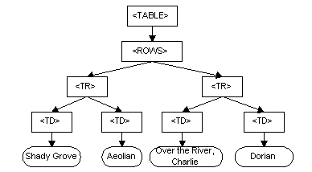
DOM Representation of the above Example Table_{[Jonathan Robie]}
The Document Object Model represents the above table like this:

Slide 82
Node
Nodes may be strictly organizational, providing a means for grouping other nodes together or for providing a point at which a hierarchy can be constructed.
Other nodes may represent visible components of a document.

Slide 83
Node Interface
Each node is based on the Node interface, which provides
  properties for getting information about the node
  as well as
  methods for creating, deleting, and organizing nodes within the DOM.

Slide 84
Characteristic of Nodes
Nodes don't have any concept of including the content that is actually displayed in the document.
Nodes are empty vessels.

Slide 85
Element Interface
The fundamental notion of a node that can represent visual content is introduced by the Element interface.
An Element object instance represents a single element in a document created using either HTML or an XML vocabulary such as SVG.

Slide 86
HTMLElement Interface
An HTML document is a DOM tree in which each of the nodes is an HTML element, represented by the HTMLElement interface.
The HTMLElement class, in turn, implements Node, so every element is also a node (but not the other way around).

Slide 87
Structural Features of HTML Elements
The structural features implemented by the Node interface are also available to HTML elements, allowing them to be nested within each other, created and deleted, moved around, and so forth.

Slide 88
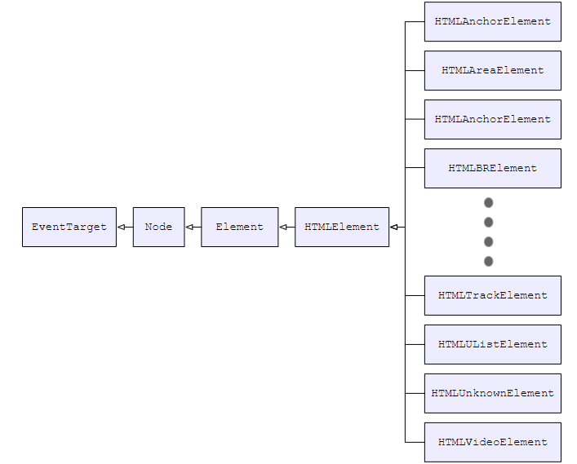
The Overall Inheritance for HTML Element Classes

Slide 89
More about HTMLElement Interface
In order to expand upon the functionality of the core HTMLElement interface to provide the features needed by a specific element, the HTMLElement class is subclassed to add the needed properties and methods.

Slide 90
Example
the <canvas> element is represented by an object of type HTMLCanvasElement.
HTMLCanvasElement augments the HTMLElement type by adding properties such as height and methods like getContext() to provide canvas-specific features.

Slide 91
JavaScript innerHTML _{[1][2][3]}

Slide 92
innerHTML _{[wibibi]}
JavaScript 的 innerHTML 其實屬於 HTML DOM 的一種功能，透過 innerHTML 可以取得或設定 HTML Code 中的元素，也可以單純的將字串寫入 HTML Code 的某一個部分。
innerHTML 可以搭配 HTML 的 Element Object 來執行，如 getElementById 或getElementsByName 等。

Slide 93
JavaScript innerHTML 基本語法_{[wibibi]}
HTMLDOMObject.innertHTML
innerHTML 常與 getElementById 或與getElementsByName 搭配使用，例如 getElementById("ID").innerHTML 就是非常普遍的一種寫法，取得網頁內的 ID 元素後，即可將想要寫入的字串或 HTML Code 寫入至 ID 元素。

Slide 94
範例 _{[wibibi]}
<script type="text/javascript">
function ShowAnswer(){
document.getElementById("AnswerBox").innerHTML='2';
}
</script>
1+1=<span id="AnswerBox">_</span>
<input type="button" value="顯示答案" onclick = "ShowAnswer()">

Slide 95

Execution _{[wibibi]}

Slide 96
Explanation _{[wibibi]}
範例一開始先寫了一個叫 ShowAnswer 的 function 準備用來顯示答案，當網友按下顯示答案的按鈕（button）後，立即被 onclick 事件監聽到，自動觸發 ShowAnswer 函式，真正的重點就來了， ShowAnswer 函式將會使用 document.getElementById 找到 id 為 AnswerBox 的 span 區域，並透過 innerHTML 將答案寫入 span 區域內，整支程式的運作即完成。

Slide 97
Background Knowledge

Slide 98
Location href Property _{[w3schools]}
The href property sets or returns the entire URL of the current page.

Slide 99
Syntax _{[w3schools]}
Return the href property:
  location.href
Set the href property:
  location.href = URL

Slide 100
Property Values _{[w3schools]}
Value | Type | Description
URL | String | Specifies the URL of the link. Possible values: An absolute URL - points to another web site (like location.href="http://www.example.com/default.htm" ) A relative URL - points to a file within a web site (like location.href="default.htm") An anchor URL - points to an anchor within a page (like location.href="#top") A new protocol - specifies a different protocol (like location.href="ftp://someftpserver.com", location.href="mailto:someone@example.com" or location.href="file://host/path/example.txt")

Slide 101
JavaScript indexOf() Method _{[w3schools]}
The indexOf() method returns the position of the first occurrence of a specified value in a string.
This method returns -1 if the value to search for never occurs.
  Note: The indexOf() method is case sensitive.

Slide 102
Syntax and Parameter Values
Syntax
string.indexOf(searchvalue, start)
Parameter Values
Parameter | Description
searchvalue | Required. The string to search for
start | Optional. Default 0. At which position to start the search

Slide 103
Example _{[w3schools]}
Search a string for "welcome":
var str = "Hello, welcome to the universe.";
var n = str.indexOf("welcome")
result: n=7;

Slide 104
Syntax and Parameter Values _{[w3schools]}
Syntax
string.substring(start, end)
Parameter Values
Parameter | Description
start | Required. The position where to start the extraction. First character is at index 0
end | Optional. The position (up to, but not including) where to end the extraction. If omitted, it extracts the rest of the string

Slide 105
JavaScript substring()Method (1) _{[w3schools]}
The substring() method extracts the characters from a string, between two specified indices, and returns the new sub string.
This method extracts the characters in a string between "start" and "end", not including "end" itself.

Slide 106
JavaScript substring()Method (2) _{[w3schools]}
If "start" is greater than "end", this method will swap the two arguments, meaning
str.substring(1, 4) == str.substring(4, 1).
If either "start" or "end" is less than 0, it is treated as if it were 0.
  Note: The substring() method does not change the original string.

Slide 107
Example _{[w3schools]}
Begin the extraction at position 2, and extract the rest of the string:
var str = "Hello world!";
var res = str.substring(2);
Result: llo world!

Slide 108
DOM-based XSS _{[1][2][3]}

Slide 109
DOM Based XSS _{[wikipedia]}
DOM Based XSS (or as it is called in some texts, “type-0 XSS”) is an XSS attack wherein the attack payload is executed as a result of modifying the DOM “environment” in the victim’s browser used by the original client side script, so that the client side code runs in an “unexpected” manner.

Slide 110
A Property of DOM Based XSS _{[wikipedia]}
The page itself (the HTTP response that is) does not change, but the client side code contained in the page executes differently due to the malicious modifications that have occurred in the DOM environment.

Slide 111
Attack Example 1

Slide 112
Example - Assumption _{[wikipedia]}
Suppose the following code is used to create a form to let the user choose his/her preferred language. A default language is also provided in the query string, as the parameter “default”.

Slide 113
Example - Code _{[wikipedia]}
<select>
<script>
document.write("<OPTION value=1>"+document.location.href.substring(document.location.href.indexOf("default=")+8)+"</OPTION>");
document.write("<OPTION value=2>English</OPTION>");
</script>
</select>
…

Slide 114
Normal Input _{[wikipedia]}
The page is invoked with a URL such as:
http://www.some.site/page.html?default=French

Slide 115
Attack String _{[wikipedia]}
A DOM Based XSS attack against this page can be accomplished by sending the following URL to a victim:
http://www.some.site/page.html?default=<script>alert(document.cookie)</script>

Slide 116
Browser’s Input _{[wikipedia]}
When the victim clicks on this link, the browser sends a request for: /page.html?default=<script>alert(document.cookie)</script> to www.some.site.

Slide 117
Server’s Response to the Attack String _{[wikipedia]}
The server responds with the page containing the above Javascript code.
The browser creates a DOM object for the page, in which the document.location object contains the string:
http://www.some.site/page.html?default=<script>alert(document.cookie)</script>

Slide 118
Result _{[wikipedia]}
The original Javascript code in the page does not expect the default parameter to contain HTML markup, and as such it simply echoes it into the page (DOM) at runtime.
The browser then renders the resulting page and executes the attacker’s script:
alert(document.cookie)

Slide 119
Explanation _{[wikipedia]}
Note that the HTTP response sent from the server does not contain the attacker’s payload.
This payload manifests itself at the client-side script at runtime, when a flawed script accesses the DOM variable document.location and assumes it is not malicious.

Slide 120
Detection at a Server _{[wikipedia]}
In the example above, while the payload was not embedded by the server in the HTTP response, it still arrived at the server as part of an HTTP request, and thus the attack could be detected at the server side.

Slide 121
A Paper Discussing Bypassing Server Detection _{[wikipedia]}
The “DOM Based XSS” paper details a technique to avoid server side detection. It also describes several other possible locations for the payload, besides document.location.

Slide 122
Advance Techniques _{[wikipedia]}
The technique to avoid sending the payload to the server hinges on the fact that URI fragments (the part in the URI after the “#”) is not sent to the server by the browser.
Thus, any client side code that references, say, document.location, may be vulnerable to an attack which uses fragments, and in such case the payload is never sent to the server.

Slide 123
Example _{[wikipedia]}
http://www.some.site/page.html#default=<script>alert(document.cookie)</script> which mounts the same attack without it being seen by the server (which will simply see a request for page.html without any URL parameters).

Slide 124
Supplementary Materials

Slide 125
Difference between Node object and Element object?

Slide 126
Content Tree _{[Mozilla} ₋ _{mdnwebdocs-bot]}

Slide 127
Content Tree _{[Mozilla} ₋ _{mdnwebdocs-bot]}
Many HTML authors may think of HTML as something flat -- a bunch of text with tags in the middle. However, it is something much more than that.
Any HTML document (or for that matter any SGML document or XML document) is a tree structure.
  For example, the following document and tree structure are similar (although not identical -- see the notes on whitespace in the DOM):

Slide 128
An HTML Document _{[Mozilla} ₋ _{mdnwebdocs-bot]}
<html>
<head>
<title>My Document</title>
</head>
<body>
<h1>Header</h1>
<p>Paragraph</p>
</body>
</html>

Slide 129
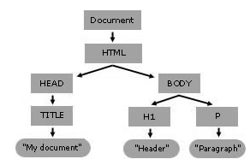
A Content Tree _{[Mozilla} ₋ _{mdnwebdocs-bot]}
Each of the boxes in the tree above is a node in the tree.

Slide 130
Document and Content Tree _{[Mozilla} ₋ _{mdnwebdocs-bot]}
When Mozilla parses a document, it builds a content tree and then uses it to display the document.

Slide 131
Script and HTML Document _{[Mozilla} ₋ _{mdnwebdocs-bot]}
The W3C DOM Level 1 allows you to change the content tree any way you want.
It is powerful enough to build any HTML document from scratch.
It allows authors to change anything in the document from script, at any time.

